Slide 1


PS done Right
The public speaker is Ben Shapiro.
He keeps his composure when he stumbles during speech with only pausing for a split sec.
Ben has excellent eye contact.
Small hand gestures.
Speaks clearly
https://www.youtube.com/watch?v=CHhFhR530RU

Slide 2
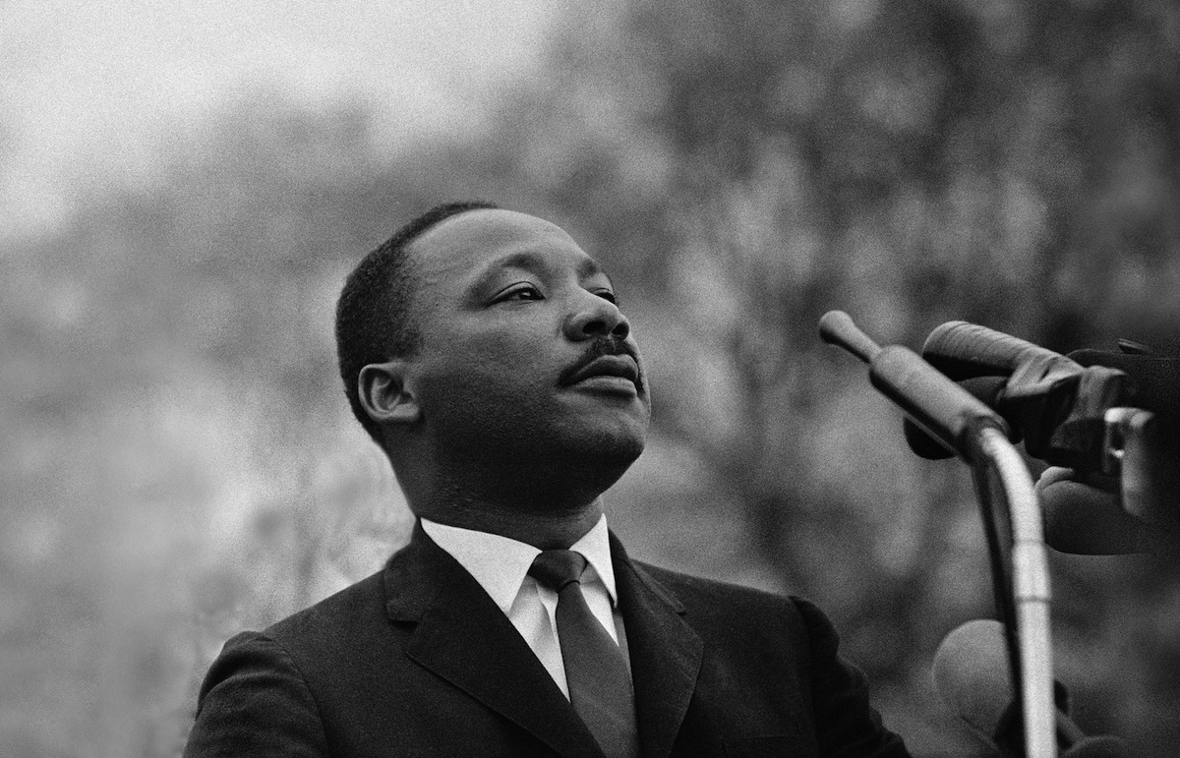
I Have A Dream
MLK’s chin is held high constantly
Shakes head his sense of righteous conviction in his mission
Pace and volume of words slowly grows
Always eye contact on crucial sections
Repetition
https://youtu.be/3vDWWy4CMhE?t=144

Slide 3
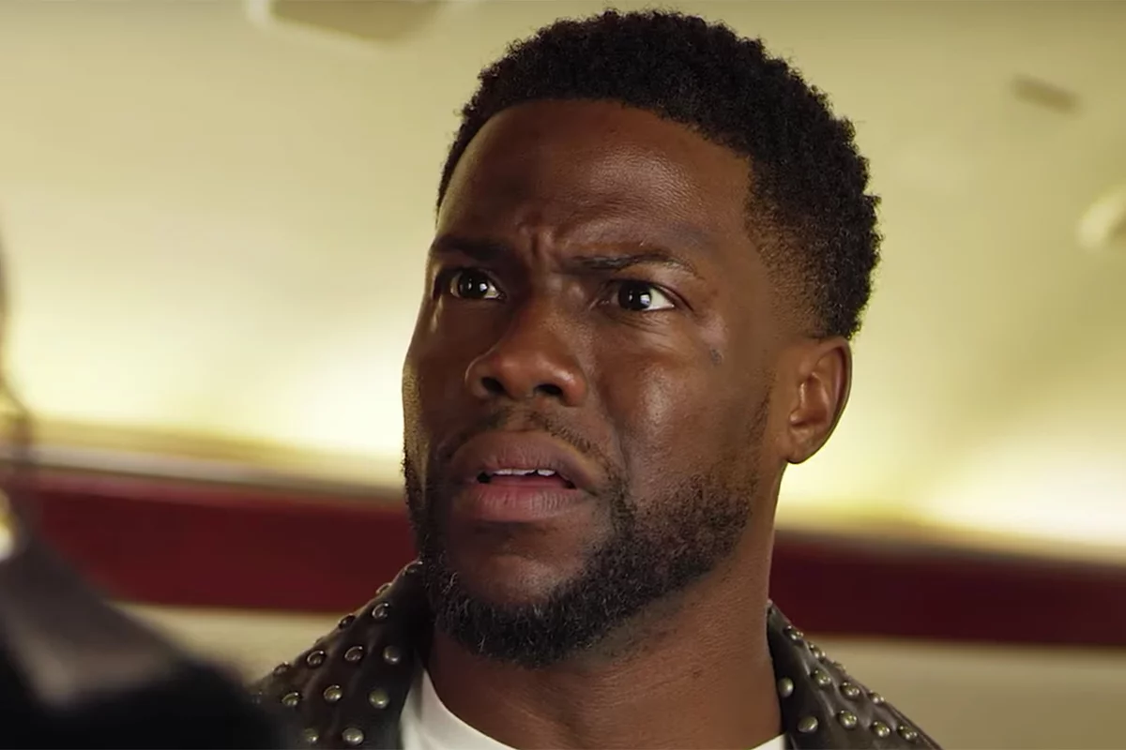
Stand Up Comedy
Kevin Hart - Ping-Pong? Really??? - Stand-Up Comedy
0:00 to 2:20
Kevin Hart is a very funny guy we all know that much.
Kevin uses a lot of hand movement and body language.
He sets his joke up nicely with a story maybe we all can relate to since we are in college
His eyes stays on the crowd to read their reaction to his joke.
He changes his voice to impersonate, but his voice levels usually stay high and sporadic when talking naturally.
His timing and effectiveness of switching from the story to giving advice was perfectly laid out and relatable.

Slide 4
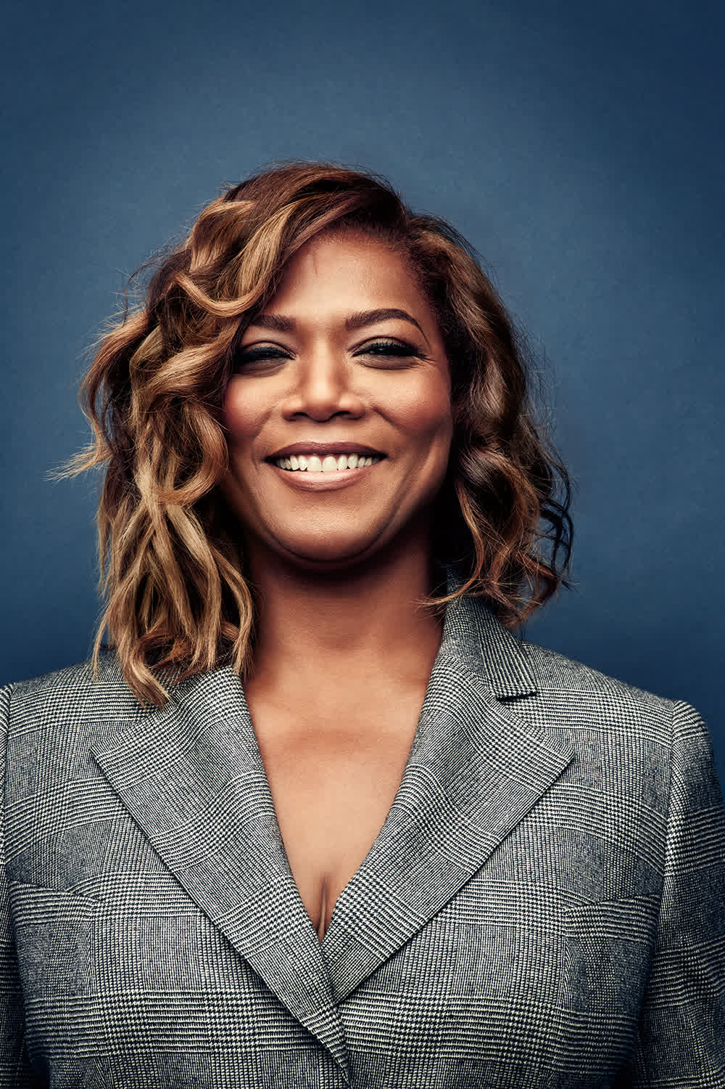
Queen Latifah's Commencement speech at Strayer University
Uses emphasis
Engaging expressions
Voice levels that add meaning
Eye contact and confidence
https://www.youtube.com/watch?v=voyB4jPsp9E

